Slide 1

Power Systems - Term Project
Submitted by Group - 5
Abhinav Barman (2021EEB1145)
Gaurav Wani (2021EEB1171)
Ranjeet Singh (2021EEB1203)
Shashwat Srivastava (2021EEB1210)
Yash Agarwal (2021EEB1225)

Slide 2
We can have 3 ppts per lecture. Roughly 12 minutes per group.
Expected content -
1. Objective/ Problem statement
2. Literature survey done > a few techniques to achieve the set target
3. Base paper chosen > its core idea in brief
4. Key results presented in the paper | Test system/data set/hardware they used
5. Expected deliverables
6. Tentative timeline for your TP
01
Objective
02
Survey
03
CONTENTS
Base Paper
04
Results
05
Deliverables

Slide 3
01
Objective
Here we focus on defining the objective or problem statement of the project.

Slide 4
Data Dimesionality Reduction
“To develop an effective data dimensionality reduction technique for synchrophasor data analysis, drawing insights from existing research on compression methods such as Singular Value Decomposition (SVD), Phasor Principal Component Analysis (PPCA), and Principal Component Analysis (PCA), to enhance storage efficiency while preserving critical information accuracy.”

Slide 5
02
Literature Survey
Exploring four key research papers

Slide 6
Key Research Papers Reviewed -
A real time synchrophasor data compression method using SVD
Synchrophasor Data Compression With Iteration-Enhanced PPCA
Efficient Compression of PMU Data in WAMS
Synchrophasor Data Compression via Cross-Entropy-Based SVD

Slide 7
03
Base Paper
Identifying the foundational research paper and summarizing its core concepts.

Slide 8
A Real-Time Synchrophasor Data Compression
Method Using Singular Value Decomposition
Introduction - Synchrophasor data, essential for power system monitoring, presents challenges in storage and processing due to its vast volume. To address this, we introduce a novel Singular Value Decomposition (SVD)-based compression method. This approach offers advanced techniques to manage the extensive synchrophasor datasets efficiently, ensuring accurate preservation of critical information while achieving high compression ratios.

Slide 9
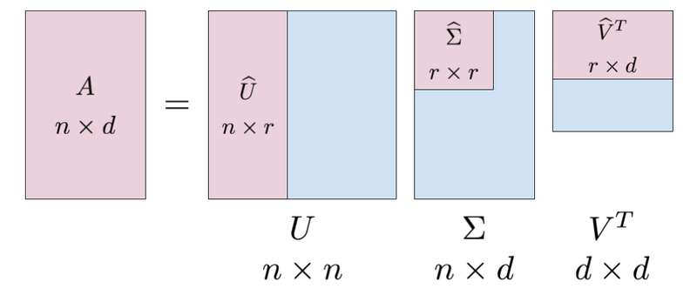
SVD Based Compression -
The SVD is a data reduction technique revealing key features from high-dimensional data by breaking down a data matrix. SVD is scalable and can be applied to wide range of data types.
The computation of the SVD involves decomposing the data matrix into three matrices: U, Σ, and V. The matrix U represents the left singular vectors, Σ contains the singular values, and V represents the right singular vectors. These matrices provide information about the underlying structure and correlations within the data.

Slide 10
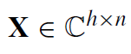
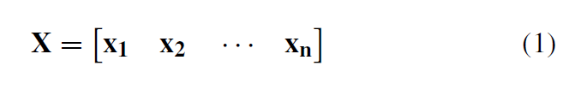
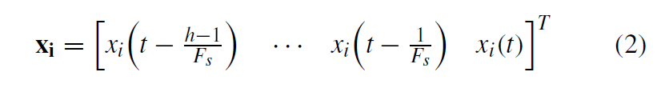
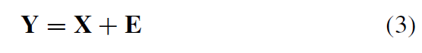
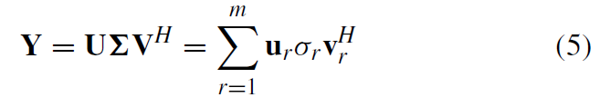
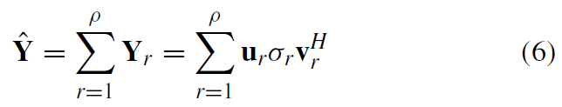
Dimensionality Evaluation & Reduction Using SVD
Let X be the ground truth matrix at time t such that

Slide 11
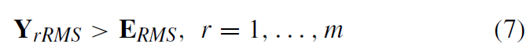
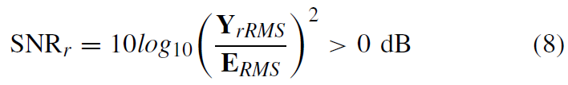
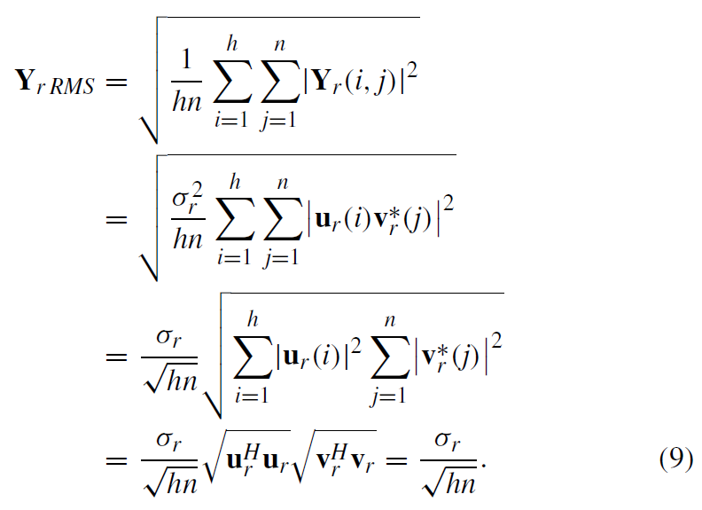

Slide 12
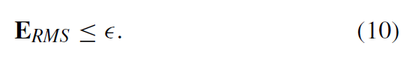
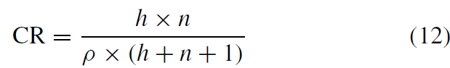
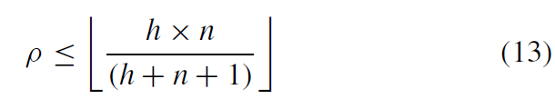
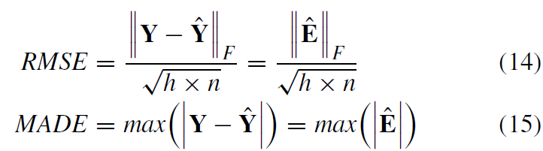

Slide 13
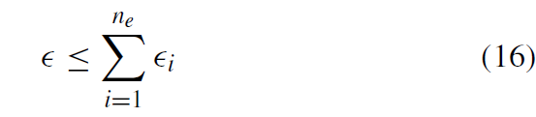
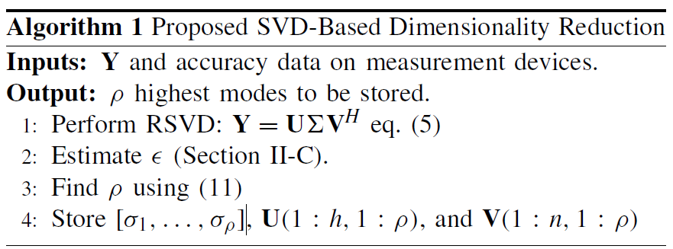
R. Pourramezan, R. Hassani, H. Karimi, M. Paolone and J. Mahseredjian, "A Real-Time Synchrophasor Data Compression Method Using Singular Value Decomposition," in IEEE Transactions on Smart Grid, vol. 13, no. 1, pp. 564-575, Jan. 2022, doi: 10.1109/TSG.2021.3114585.

Slide 14
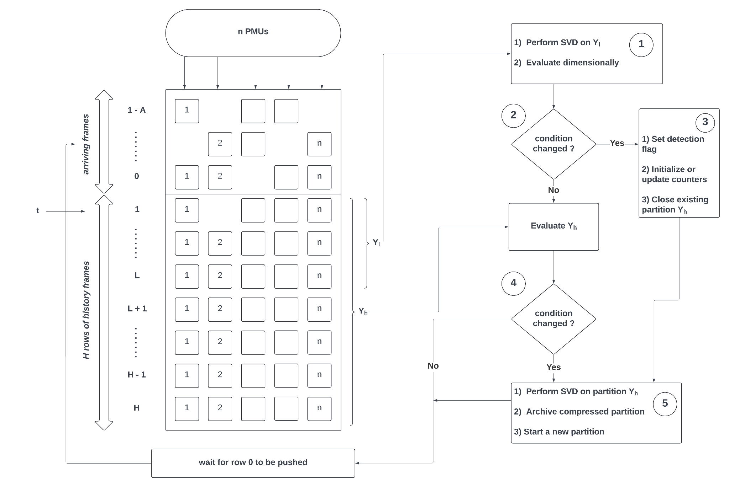

Slide 15
Progressive Partitioning Techniques
Why is Classic Partitioning failing?
Progressive Partitioning further divides the disturbance data into severe and less severe transients into different dimensionality.
R. Pourramezan, R. Hassani, H. Karimi, M. Paolone and J. Mahseredjian, "A Real-Time Synchrophasor Data Compression Method Using Singular Value Decomposition," in IEEE Transactions on Smart Grid, vol. 13, no. 1, pp. 564-575, Jan. 2022, doi: 10.1109/TSG.2021.3114585.

Slide 16
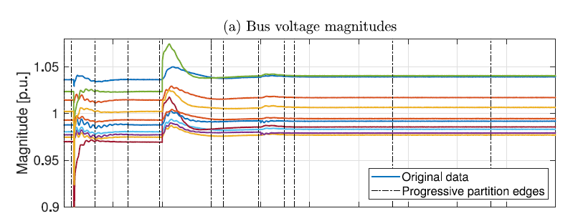
Progressive Partitioning Method
Track changes in estimated rank of the data in circular buffer
Disturbance Encountered → Rank increases to maximum estimated value
Rank increases during severe disturbances and gradually decreases as the disturbances dampen down
R. Pourramezan, R. Hassani, H. Karimi, M. Paolone and J. Mahseredjian, "A Real-Time Synchrophasor Data Compression Method Using Singular Value Decomposition," in IEEE Transactions on Smart Grid, vol. 13, no. 1, pp. 564-575, Jan. 2022, doi: 10.1109/TSG.2021.3114585.

Slide 17
Progressive Partitioning Algorithm
Input : l, h, ф , n , ρ, α, Y_{l-1}
Detection flag ф takes the values based on the following conditions:
Data of timestamp t is pushed into matrix Y_{l}.
SVD calculates the estimated rank ρ.Assuming initially ф = 0.
while (ф == 0) :
if(no change detected)
Y_{h} marked normal partition and sent to SVD for compression;
else if(change detected by increase in rank)
ф = 1;
R. Pourramezan, R. Hassani, H. Karimi, M. Paolone and J. Mahseredjian, "A Real-Time Synchrophasor Data Compression Method Using Singular Value Decomposition," in IEEE Transactions on Smart Grid, vol. 13, no. 1, pp. 564-575, Jan. 2022, doi: 10.1109/TSG.2021.3114585.

Slide 18
Progressive Partitioning Continued
while( ф == 1) :
Estimate ρ and calculate ρ_{max} and ρ_{avg}
Keep last l/2 data points and pass the rest as normal condition.
n = n + 1;
if(ρ_{avg} < αρ_{max}) :
ф = 2 ; //transitions damped
send partition(ф =1) to SVD algorithm
start new buffer
if(n >= l) :
send the partition (ф =1) to SVD algorithm and restart
ф =0 , n = 0
R. Pourramezan, R. Hassani, H. Karimi, M. Paolone and J. Mahseredjian, "A Real-Time Synchrophasor Data Compression Method Using Singular Value Decomposition," in IEEE Transactions on Smart Grid, vol. 13, no. 1, pp. 564-575, Jan. 2022, doi: 10.1109/TSG.2021.3114585.

Slide 19
Remarks and Summary
Computational Efficiency Tradeoff :
Parameter l should be small enough to reflect the rank change and large enough to detect temporal changes.
Selection of α :
The value of α lies between 0 and 1.
It is used to set the upper bound of ρ_{avg.}
Smaller values will result in larger partitions as the estimated rank will be greater than this bound for longer time.
R. Pourramezan, R. Hassani, H. Karimi, M. Paolone and J. Mahseredjian, "A Real-Time Synchrophasor Data Compression Method Using Singular Value Decomposition," in IEEE Transactions on Smart Grid, vol. 13, no. 1, pp. 564-575, Jan. 2022, doi: 10.1109/TSG.2021.3114585.

Slide 20
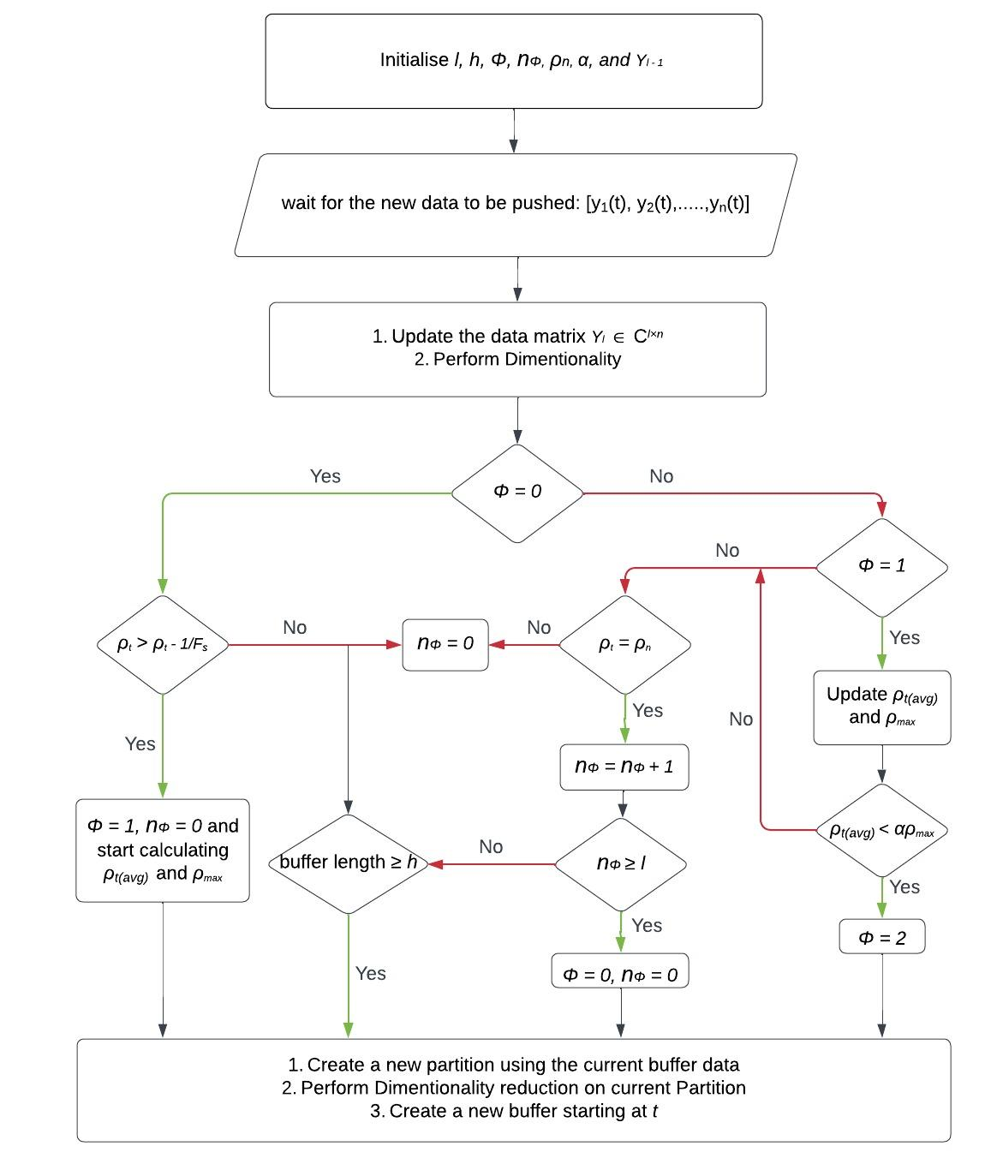

Slide 21
04
Key Results
Results tested on IEEE-12 & IEEE-14

Slide 22
DataSet used -
Simulated PMU Data of the IEEE-14 & 12 Test Case: Placement of many PMUs with reporting rate Fs = 60 fps for different types of faults. Fault occurs at around 2 seconds for 20 seconds dataset which consists of 1200 samples.

Slide 23
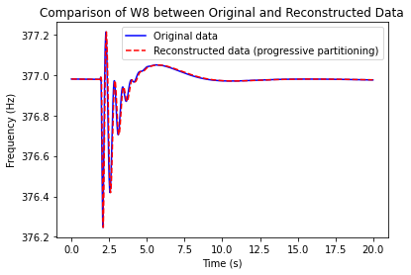
Key Results -

Slide 24
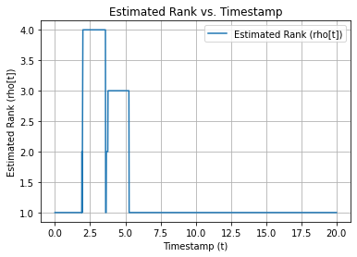

Slide 25
05
Conclusion
Validation and comparison of compression methods.

Slide 26
Deliverables-
Validation of the proposed compression method using simulated synchrophasor data.
Assessment of the method's performance metrics such as Compression Ratio (CR), Root Mean Square Error (RMSE), and Maximum Absolute Deviation Error (MADE).
Comparison of compression results between our method and Weikang’s entropy based SVD method.
Insights into the effectiveness and efficiency of the compression method under different test conditions.

Slide 27
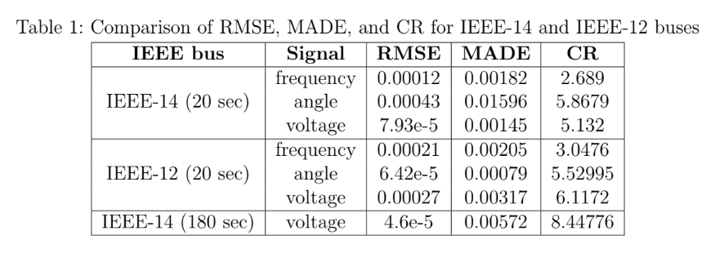

Slide 28
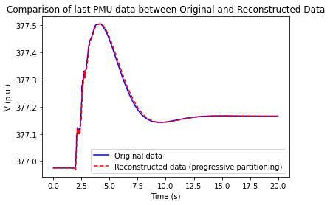
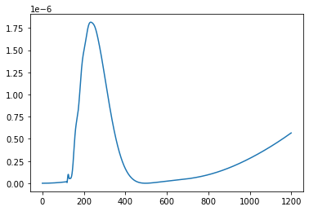
Our method against entropy SVD method-
CR = 3.0476
CR = 1.6560

